Slide 1
SAV Overview

Slide 2
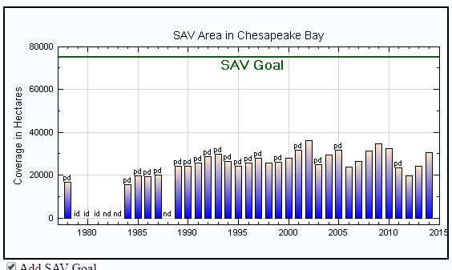

Slide 3
What are the reasons there is not much SAV in the Bay?
Sediment pollution
Increased sediment decreases water clarity which means sunlight cannot reach the SAV
Nutrient pollution
Increased nutrients leads to algae blooms which can block the sunlight
Elevated water temperature

Slide 4
Why is SAV important to the Bay?
Food source
Provides shelter
Increases oxygen in the water
Roots trap sediments

Slide 5
How can SAV serve as an indicator of the health of the Bay?
A lot of SAV = clear water = a good sign for the Bay

